Slide 1
Sharpening Analytic Skills
Fulton T. Armstrong
Course # SIS-730-010
Friday 10/27 | Saturday 10/28 | Sunday 10/29
5:30pm - 8pm | 9am - 5pm | 9am - 5pm
SIS-333 | SIS-355 | SIS-355

Slide 2
 |  |  |  |  | 27 | 28
29
AGENDA
THE DECISIONMAKER AND “ACTIONABLE” ANALYSIS
✓
✓
The decisionmaker’s needs
Developing the right question
Tradecraft and its importance in critical thinking
Models, techniques, tricks
Drivers, scenarios, alternatives, wildcards, implications
Guaranteeing quality, integrity

Slide 3
 |  |  |  |  | 27 | 29
29
AGENDA
Implementing the full model
Providing comments
Reinforcing skills
Avoiding pitfalls, pressures
How others train analysts
Preparing for production
✓
PRACTICING AND PREPARING “ACTIONABLE” ANALYSIS

Slide 4
 |  |  |  |  | 27 | 28
29
5
AGENDA
✓
✓
FINAL DUE
✓

Slide 5
Before we begin … QUESTIONS? COMMENTS? PREFERENCES?

Slide 6
What is Analysis?
REVIEW
In the broadest sense …
Analysis is the process of evaluating and transforming raw data into descriptions, explanations, and conclusions that help readers (policymakers) take action.
ANALYSIS IS ACTIONABLE.

Slide 7
REVIEW
Elements
WHAT is going on
WHY it is going on
WHERE it is going
WHY we should care
Framing; factual laydown
Drivers
Trends and, later, scenarios
Implications

Slide 8
REVIEW
Elements
Drivers
Trends
Scenarios
Probable
Less Probable
Wild cards
Implications
HANDOUT G

Slide 9
REVIEW
The Heartbeat of Analysis
(… and POLICY)
“DRIVERS”

Slide 10
REVIEW
What are drivers?
Interests
Borrowing from the “3-i framework” …
Ideas
Institutions
In our PERSONAL lives …
Interests | Ideas | Institutions
Work Food Love - Sex Family Home Transportation Entertainment Recreation Challenges | Education Religion or values Political thought Ideology Imposed expectations | Parents Boy/Girlfriend Husband/Wife Colleagues Friends Political party Employer
drivers

Slide 11
REVIEW
What are drivers?
Interests
Borrowing from the “3-i framework” …
Ideas
Institutions
In our NATIONAL lives …
Interests | Ideas | Institutions
Power/influence Needs Desires/ambitions Wealth Economic performance | Self-definition Nationalism History Concepts/logic Values Ideology | Leadership Abilities/constraints Economic structures Intermediation Inclusion Topography/geography Climate
drivers

Slide 12
REVIEW
What are drivers?
“FUEL”
“FRICTION”
Effort/energy
Resources
Technology, etc.
to PUSH a solution.
Obstacles
Resistence
Limitations, etc.
that OBSTRUCT a solution.
“Forward” drivers
“Status Quo” or “Backward” drivers
Organizational psychologist Loran Nordgren: Focus on the “invisible” obstacles
Examples

Slide 13
REVIEW
Building the Principal Scenario
driver and trend
Principal Scenario
driver and trend
driver and trend
driver and trend
driver and trend
driver and trend

Slide 14
REVIEW
Building the ALTERNATIVE Scenario
driver and trend
driver and trend
driver and trend
driver and trend
Alternative Scenario
driver and trend
driver and trend

Slide 15
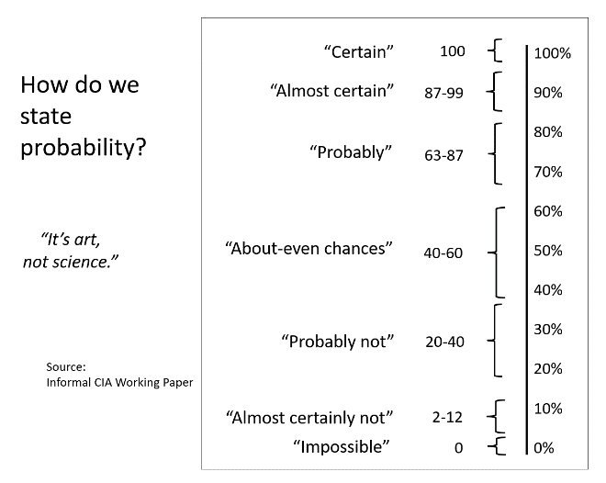
REVIEW
“Certain”
100
100%
90%
80%
70%
60%
50%
40%
30%
20%
10%
0%
“Almost certain”
87-99
How do we state probability?
“Probably”
63-87
“About-even chances”
40-60
“Probably not”
20-40
“It’s art, not science.”
“Almost certainly not”
2-12
HANDOUT L
Source: Informal CIA Working Paper
“Impossible”
0

Slide 16
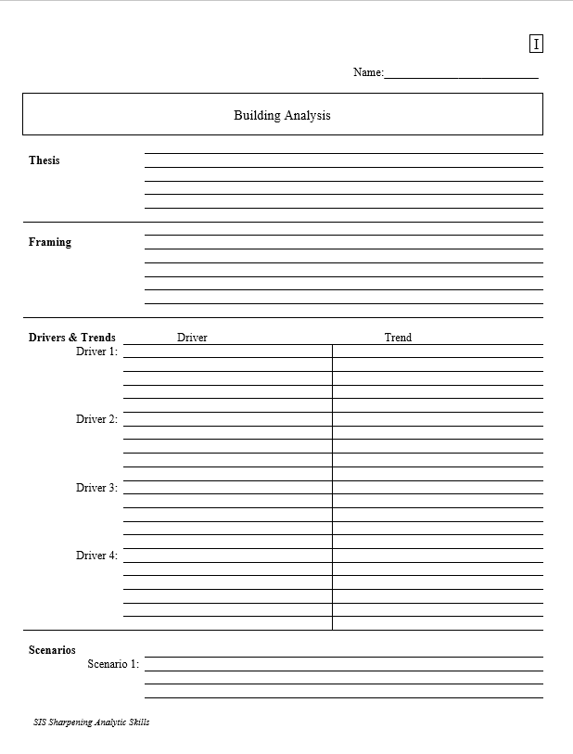
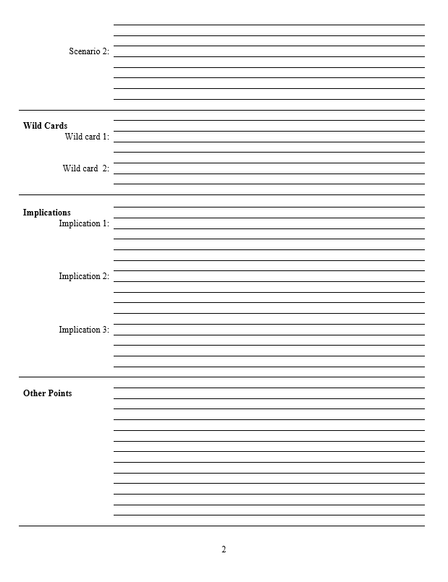
REVIEW
So, with a thesis sentence at the top, that’s the whole model.

Slide 17
QUIZ
HANDOUT I

Slide 18
Questions or concerns?

Slide 19
EXERCISE
Write a Snowflake on your TEAM topic.

Slide 20
THREE MAIN ELEMENTS
What’s happening?
Why or how is it happening?
What’s going to happen? or Why does it matter?
SNOWFLAKE
In 40 words,
Write a thesis or conclusion.
Write an argument or explanation.
Write something about future or implications.
POST IT IN FIRST “ASSIGNMENT” IN TODAY’S MODULE.
__ minutes

Slide 21
Next … wild cards!

Slide 22
“Wildcards”
Extremely low probability; impossible to predict … but …
Changes our analysis drastically
Something that, in our list of assumptions, we calculate as beyond our analysis
HINT - HINT

Slide 23
“Wildcards”
EXAMPLES
Leader’s death by natural cause
Assassination without any indications
Natural disasters, epidemics, etc.
Factors that we can’t analyze.

Slide 24
Wild Cards in this Exercise?

Slide 25
“Wildcards”
What are some wildcards that would turn your analysis of some current events on its head?
China’s push into the South China Sea
North Korea’s push for a nuclear weapon
Cocaine production in Colombia
Global warming
UK implementation of Brexit
Palestine’s pursuit of statehood
Cyber-attacks
The cost of a barrel of oil
(Other topics you follow)

Slide 26
Next … last but not least … implications!

Slide 27
Analyzing Implications
What importance do the current situation and the scenarios have for the decisionmaker?
Why should they pay attention?
How can events affect their interests?
Assumes, of course, knowledge of decisionmaker and interests.

Slide 28
Analyzing Implications
Warning analysis
vs
Opportunity analysis
(implicit or explicit)

Slide 29
Analyzing Implications
SCENARIO: War
EXAMPLES
humanitarian crisis
uncontrolled migration
disorder
SCENARIO: Inconclusive elections
political tensions
indecision
harm to institutions
SCENARIO: Economic decline
unemployment
popular suffering
tensions
weak institutions

Slide 30
Analyzing Implications
SCENARIO: Global warming
EXAMPLES
reduced ag production
water shortages
threat to coastal cities
SCENARIO: Manipulation of social media
threaten legitimacy
undermine institutions
youth disorientation
SCENARIO: New patents (5G)
monopolies
insecurity, doubt
international tensions

Slide 31
Analyzing Implications
What are some IMPLICATIONS of the different scenarios of some current events?
China’s push into the South China Sea
North Korea’s push for a nuclear weapon
Cocaine production in Colombia
Global warming
UK implementation of Brexit
Palestine’s pursuit of statehood
Cyber-attacks
The cost of a barrel of oil
(Other topics you follow)

Slide 32
So, with a thesis sentence at the top, that’s the whole model.
Thesis sentence: Main conclusion.
“Bottom Line Up Front.”
Short, concise summary – including as many elements as needed to tell the whole story.

Slide 33
So, with a thesis sentence at the top, that’s the whole model.
Other Points | Things that don’t fit in rigid structure
 | Give color, texture to analysis
 | Useful in building “narrative” when you write
 | Pet facts, thoughts that you like!

Slide 34
That’s the whole model.
Questions? Comments?
In a few moments … you will use it to analyze the issue of your choice.

Slide 35
So, with a thesis sentence at the top, that’s the whole model.
Questions? Comments?
In a few moments … you will use it to analyze the issue of your choice.

Slide 36
My analysis may be brilliant, but how can I be sure?
Is there something I’m missing?
Are there other interpretations to explore?
How can I improve my analysis?

Slide 37
My analysis may be brilliant, but how can I be sure?
Have I examined everything? Have I been fair?
Handout M

Slide 38
BRAINSTORMING
Purpose:
Ensure analysis considers all relevant information and interpretations
IDEAS
Definition:
Process of liberating ourselves from established line, avoiding linear thinking, and building confidence in the completeness of our analysis.
Guidelines:
Neutral peer leader
No judging
Quantity over quality
No defending
Keep the ball moving
Loose structure
Everyone talks
Keep it light

Slide 39
TIPS and TRICKS
Write notes before talking starts – to avoid “anchoring bias.”
Cast the question with a different actor – e.g., “What would X do?
Write and talk quickly – without filtering.
Do not judge your or others’ ideas – just keep moving.
Consider something funny – e.g., substituting animals for people.
Carry someone else’s idea to next step(s).
Try “starbursting” – i.e., thinking of rapid-fire questions about the topic.

Slide 40
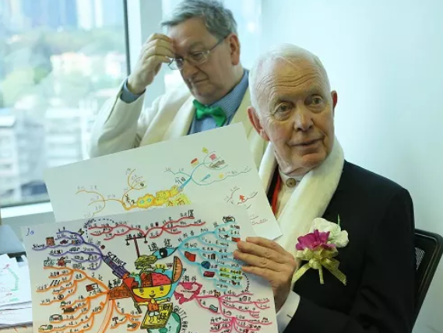
A useful way of organizing thoughts …
MIND-MAPPING
Using a diagram to show the relationships between facts and thoughts
hierarchical
cause-effect or sequence
can include wild cards???
British academic Tony Buzan
(1942-2019)

Slide 41
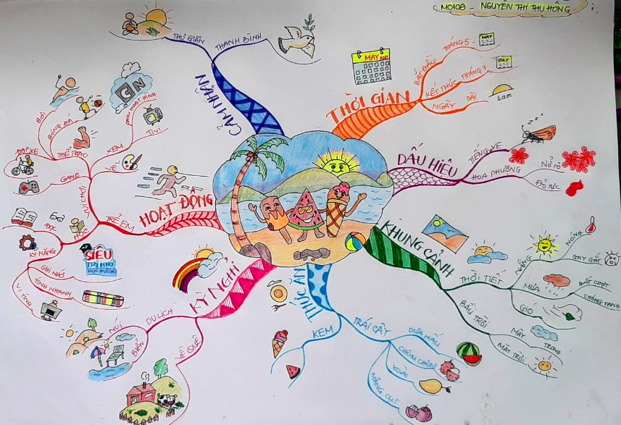
FIRST PLACE on recent WORLD MIND MAPPING DAY : Nguyen Thi Thu Hong – VIETNAM

Slide 42
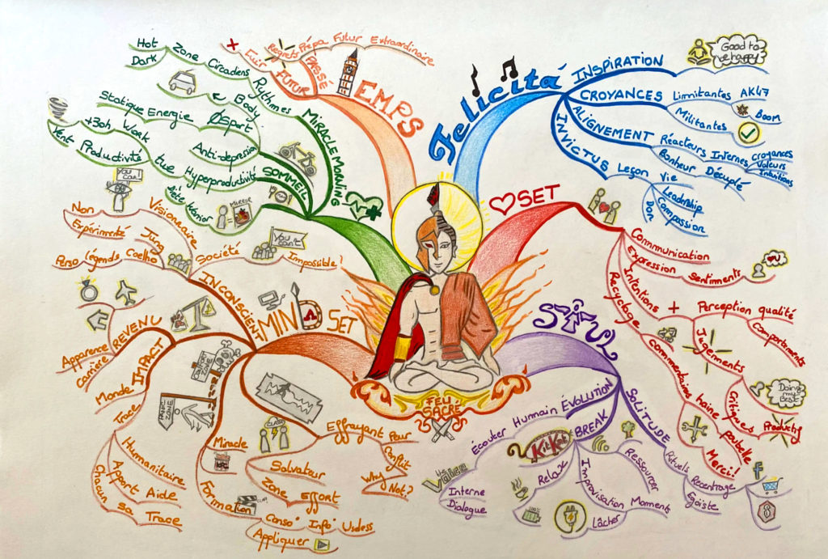
SECOND PLACE: SPAIN (in French)

Slide 43
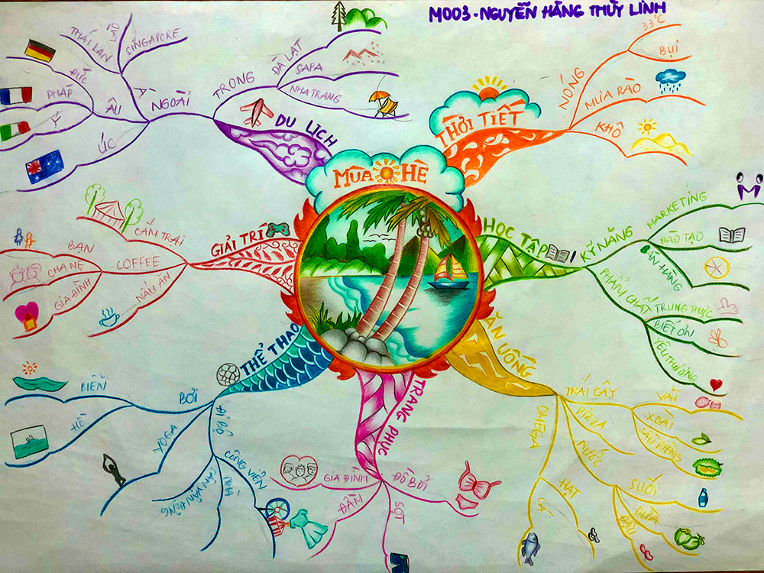
THIRD PLACE: VIETNAM

Slide 44
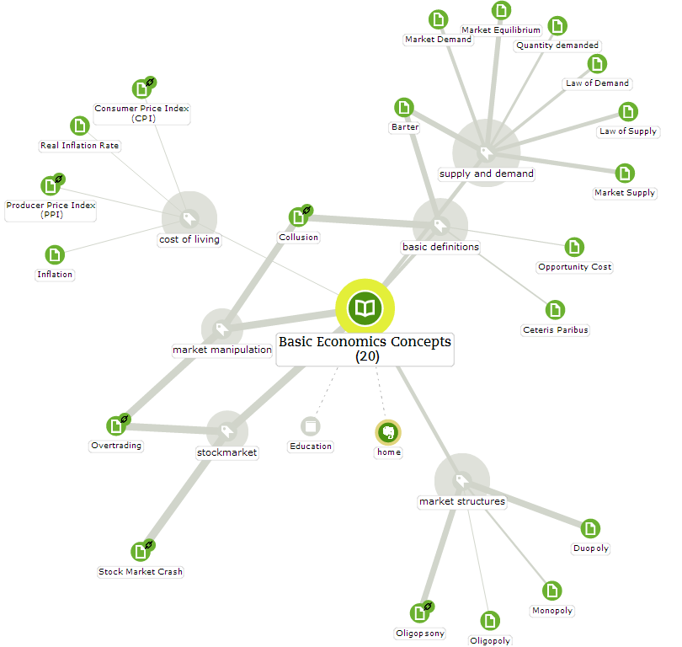
Mind map showing broad concepts for studying economics, with concepts tagged by perceived significance.

Slide 45
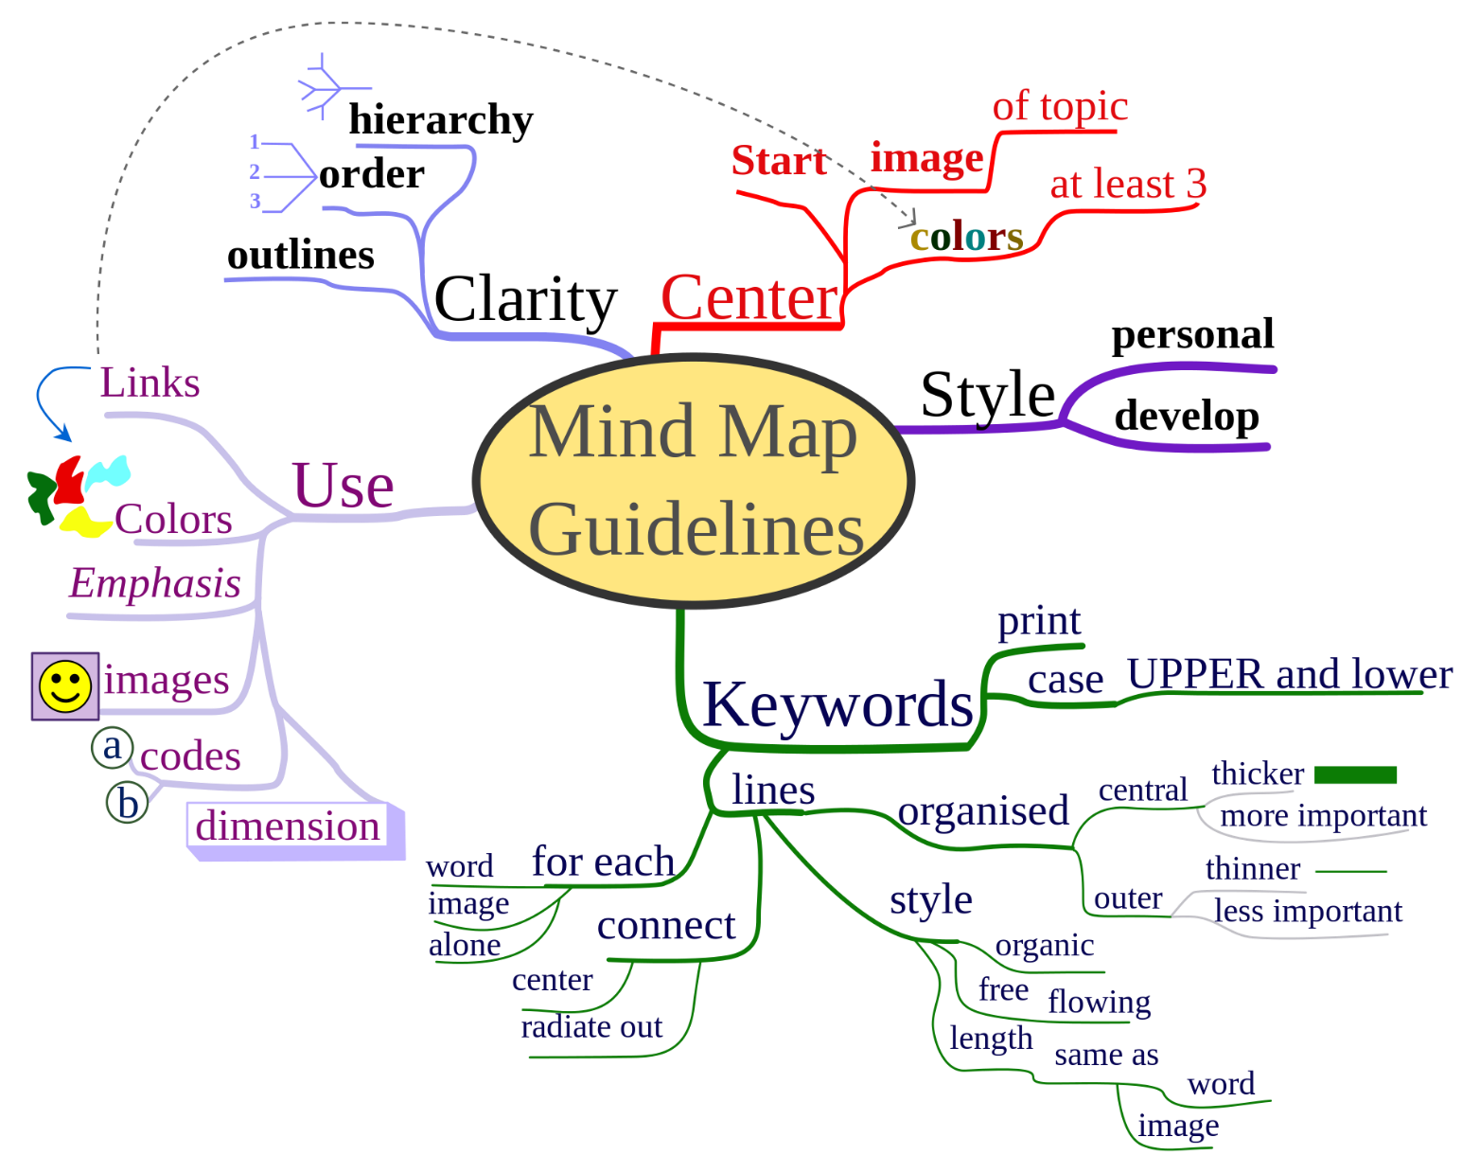

Slide 46
A Simple Mind Map
Isolation
Sense of abandon- ment
Economic
Poverty
Desperation
Central American Migration
Climate change
Violence
Gang threats
Vulnerable children
“Push” factors
“Pull” factors
“Mega Drivers”
Perceptions of ...
Corruption
Aloof elites
Can enter
Security programs
Unreliable, predatory police
Inadequate taxation
Weak institutions
Prefer “personal” solution (i.e., corrup-tion)
Get job
Safe
Social programs
Education
Medical
Build future

Slide 47
A Simple Mind Map
Isolation
Sense of abandon- ment
Economic
Poverty
Desperation
Central American Migration
HANDOUT M
Climate change
Violence
Gang threats
Vulnerable children
“Push” factors
“Pull” factors
“Mega Drivers”
Perceptions of ...
Corruption
Aloof elites
Can enter
Security programs
Unreliable, predatory police
Inadequate taxation
Weak institutions
Prefer “personal” solution (i.e., corrup-tion)
Get job
Safe
Social programs
Education
Medical
Build future

Slide 48
Simple Example
Isolation
Sense of abandon- ment
Economic
Poverty
Desperation
Central American Migration
Climate change
Violence
Gang threats
Vulnerable children
“Push” factors
“Pull” factors
“Mega Drivers”
Perceptions of ...
Corruption
Aloof elites
Can enter
Security programs
Unreliable, predatory police
Inadequate taxation
Weak institutions
Prefer “personal” solution (i.e., corrup-tion)
Get job
Safe
Social programs
Education
Medical
Build future

Slide 49
Would brainstorming and mind-mapping help you?

Slide 50
Brainstorming questions
What else could happen?
Who else could intervene?
Where else could things go right/wrong?
When else have we seen something like this?
What if we thought of ___ as a ____?
What other wild cards could appear?
What are we missing?
What blinders do the leaders involved have?
What’s the best-case (fantasy) scenario, and how could it come about?
What’s the worst-case (nightmare) scenario, and how could it come about?

Slide 51
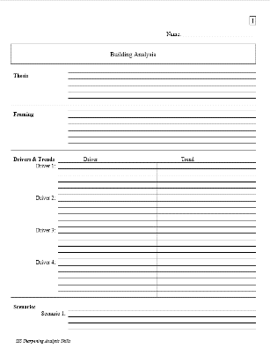
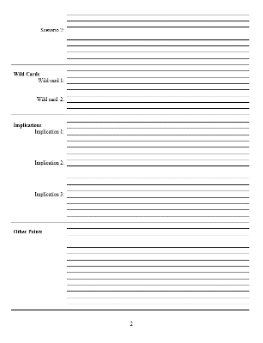
Your Projects
HANDOUT H
Friday and yesterday…
Learn about framing, drivers, trends
Learn about scenarios, wild cards, and implications
Today
Prepare first draft of worksheet
Peer review/feedback
Discussion
Sunday 11/5
Submit FINAL worksheet

Slide 52
UPDATE
TOPICS
Analyst | Topic | Peer
Dustin
Tyisse
Bridget
Alyssa
Madelyn
Lia
Blake
Elise
Veronica
Carla
Interest in each other’s topics.

Slide 53
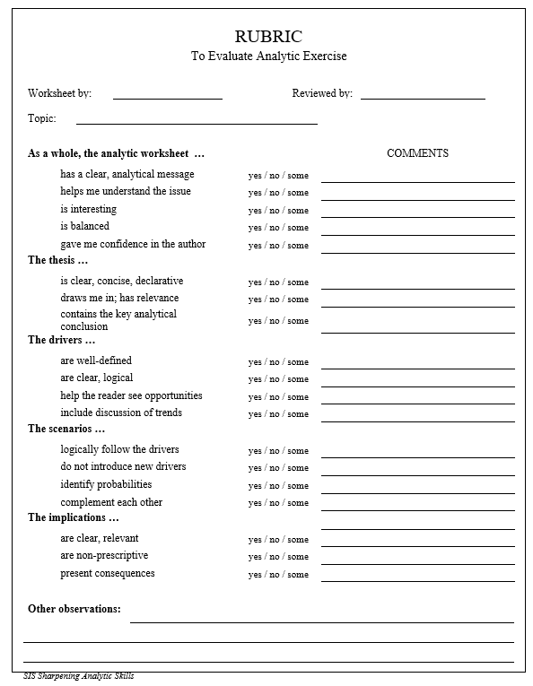
O
The Rubric
For your planning …
and
Your peer’s reviewing
Look right to you?
HANDOUT O

Slide 54
The Analytical Worksheet
H
IN WORD “FORM”
HANDOUT H (plus send Word “form”)

Slide 55
The Analytical Worksheet
H
ALSO IN WORD “FORM” IN CANVAS IN
“HANDOUTS” MODULE
HANDOUT H (PDF and Word)

Slide 56
Your Projects
How much quiet time (and consultations with prof) do you need before sharing your first draft of PART ONE – framing, drivers, and trends – with your peer?
Ready to get deeper into your topic?
Before you do, tell the whole group (30 secs) your …
Your analytical question
The drivers you’ve already identified
The trends the drivers are showing
__ minutes

Slide 57
Before you brief your peer, any questions?
Briefings in two rounds of 10 minutes each
As ANALYST …
State the analytical question you’re answering
Provide essential framing facts
Walk through drivers and trends
Receive reactions
As PEER …
Be the smart, curious generalist
Listen, think
Identify things that are unclear
Use rubric to comment

Slide 58
TOPICS and PEERS
UPDATE
 | Analyst | Topic | Peer | Round
1
2
3
4
5
6
7
8
9
ROUND A
10 minutes

Slide 59
TOPICS and PEERS
UPDATE
 | Analyst | Topic | Peer | Round
1
2
3
4
5
6
7
8
9
ROUND B
10 minutes

Slide 60
How did it go? Was the model easy to apply?
Is the rubric looking good? Can you adapt it to your topic?
Did peers ask helpful questions?

Slide 61
Your Projects
Ready to do PART TWO?
How much quiet time (and consultations with prof) do you need to write PART TWO – scenarios, wild cards, implications?
__ minutes

Slide 62
Before you brief your peer, any questions?
AGAIN … briefings in two rounds of 10 minutes each
As ANALYST …
State the analytical question you’re answering
Provide essential framing facts
Walk through drivers and trends
Receive reactions
As PEER …
Be the smart, curious generalist
Listen, think
Identify things that are unclear
Use rubric to comment

Slide 63
TOPICS and PEERS
UPDATE
 | Analyst | Topic | Peer | Round
1
2
3
4
5
6
7
8
9
ROUND A
10 minutes

Slide 64
TOPICS and PEERS
UPDATE
 | Analyst | Topic | Peer | Round
1
2
3
4
5
6
7
8
9
ROUND B
10 minutes

Slide 65
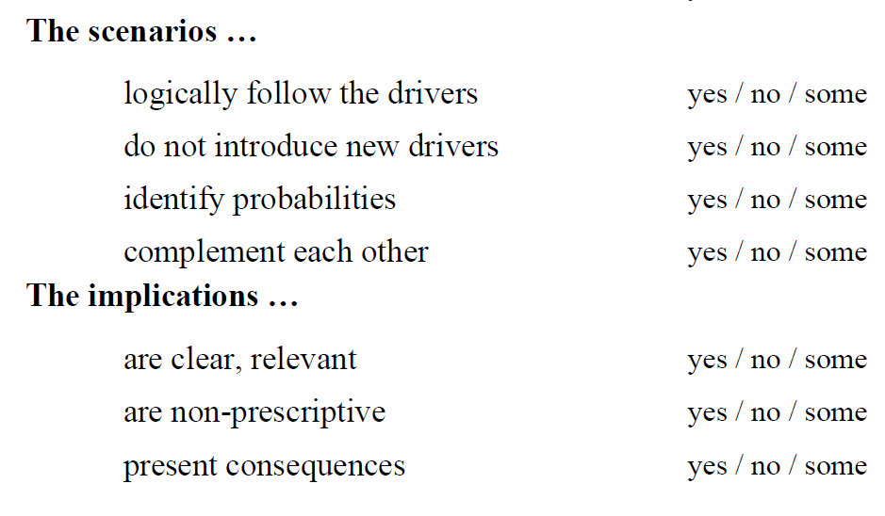
How did it go? Was the model easy to apply?
Is the rubric looking good?
Did peers ask helpful questions?
Scenarios and implications
“Other points”

Slide 66
Let’s do it. (Submit in assignment in today’s module.)
Can you write a snowflake or do an elevator briefing on your topic?
___ minutes

Slide 67
What do you have?

Slide 68
OTHER ANALYTIC MODELS
A rapid tour

Slide 69
“The Drivers Model”
Advantages
Efficient structure
Transparency
Flexibility
And … most important:
IMHO GREATEST VALUE to decisionmaker because …
Good policy is based on drivers.
BUT THERE *ARE* OTHER MODELS WITH CLEAR VALUE TOO

Slide 70
Other Models
Chronological | Helps establish possible cause-effect of events

Slide 71
Other Models
coca
pasta
cocaine
packaging
transport
distro & sales
Flow chart | Clarifies processes

Slide 72
Other Models
“Value-chain” | Indicates the value-added at each stage of a process … for economic analysis and certain criminal analysis
Precursors (Location A)
Transfer cash
Final product (Location B)
Transfer cash
Commercialization (Location C)
Transfer cash

Slide 73
Other Models
“Event-flow” | Indicates the patterns in a series of events, including places, victims, circumstances, suspects, etc. … for criminal analysis

Slide 74
Other Models
Decision Matrix | Helps achieve an understanding of the interests (and decision costs) of decisionmakers
Most basic structure: | Strengths Weaknesses Opportunities Threats
W
S
T
O

Slide 75
Other Models
Link Analysis | Reveals the relationships between posible actors … useful for CT, CN, and criminal analysis

Slide 76
Other Models
Scenarios Quadrant | Explores possibilities based on variable key factors
authoritarian government
authoritarian government command economy
authoritarian government command economy
market economy
command economy
democratic government market economy
democratic government
command economy
democratic government

Slide 77
But … (as I’ve said ___ times)
The DRIVERS model does more
Combines many elements of other models
Gives the decisionmaker something ACTIONABLE

Slide 78
Q: Now what do you do with your analytic worksheet?
A: Transform it into whatever product your decisionmaker needs.
How?

Slide 79
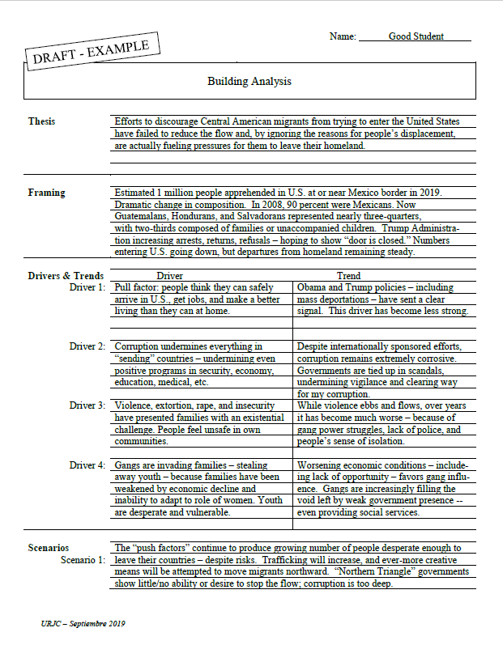
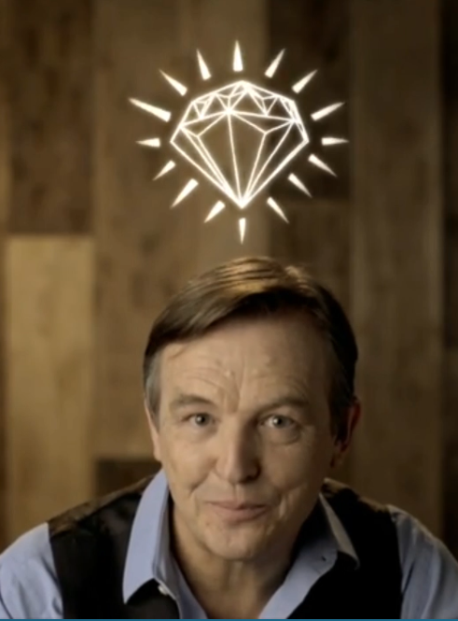
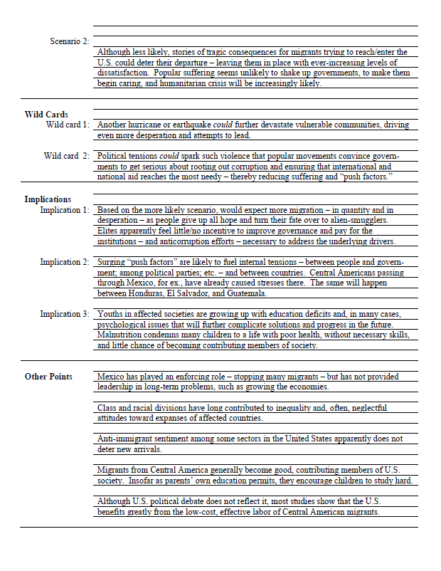
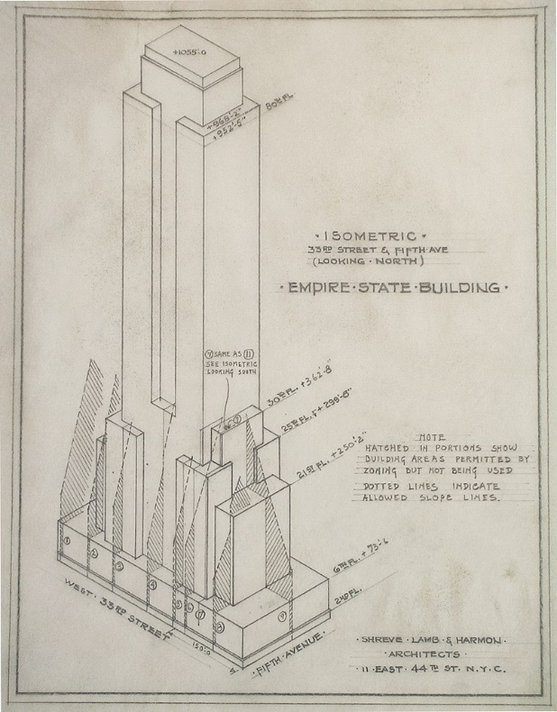
Using the parts that you need …
To create a narrative
To give the decisionmaker the info/ analysis they need
The Extraordinary Gift

Slide 80
Is there a “perfect” format for analysis (written and oral)?
No, but here’s the guideline we discussed:
HANDOUT G

Slide 81
Clear?
Make sense?
Can you use it?

Slide 82
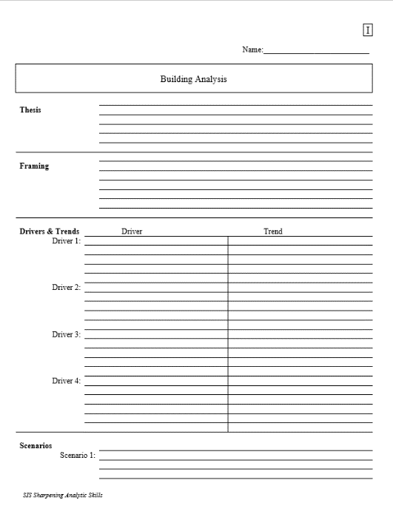
Your Projects
please use me as you fill out your analytical worksheet. I’m here
____ minutes

Slide 83
O
PEERS: Post the rubric in the same Discussion thread as the analyst posts the draft Part 2.
Put your name on it.

Slide 84
FINAL PROJECT
CLEAR?
Thesis (BLUF)
Framing
Drivers/Trends
Scenarios
Wild Cards
Implications
Other Points
Prepare a final version of your analytical worksheet
CLEAR?
Use HANDOUT H (Word “form” of Analytic Worksheet) to write, but submit in PDF
Submit in “Final Assignment” are in Followup module
Deadline: 9:00pm on Sunday, 5 November
CLEAR?

Slide 85
FINAL PROJECT
Does EVERYONE understand?

Slide 86
Everyone clear on what they’re going to be doing?
15 mins each
If you’re not either analyst or partner, take a break
Round One
Know your role in each round?
Analyst
Partner
On break
Round Two
Round Three
Professor will remain on-line for ANY consultation
Will go into your breakout room
Just text me

Slide 87
DISCUSSION: ANALYSTS’ CHALLENGES

Slide 88
Other issues …
Politicization
The analyst’s value-added
Institutional cultures and values
Dealing with clients
Maintaining morale

Slide 89
Politicization
What is it, and why is it bad?
Why and how does it happen?
What forms does it take?
What is the role of feedback?

Slide 90
Politicization
How about “reverse” politicization – when we do it?
What is it, and why is it bad?
Why and how does it happen?
What forms does it take?

Slide 91
Politicization
How do we prevent either variety of politicization?
Good tradecraft and transparency
Be honest about reporting
Set aside institutional preferences
Don’t be influenced by access
Stay up on policy and political developments
Think like a policymaker
Remember how “national interests” are determined
Respect people’s views. Respect processes. Respect institutional roles. Respect democracy

Slide 92
TRADECRAFT: Vaccination against Politicization

Slide 93
Institutional cultures
All are different, and all tend to stifle over time.
Find your space. Get out of it from time to time.
Remember you’re not the boss.
Dealing with clients
Understand their equities, culture, language.
But stay out of their space, and keep them out of yours.
Beware manipulation (e.g., access). Beware feedback.
Professionalism – not friendship.

Slide 94
Our value-added
What’s our unique contribution?
Clandestine or special info?
Subject expertise?
Timeliness?
Tradecraft?
Lack of agenda?
Warning or opportunity analysis?
Are we basically an internal news outlet competing with external news outlets?

Slide 95
Our customers
Who are our customers?
Executive branch only?
Our operational colleagues?
Private-sector contacts?
Press (via backgrounders)?
“The people” (e.g., white papers)

Slide 96
While you’re in “ANALYSIS MODE”...
NEVER …
NEVER …
Never …
NEVER …
NEVER …
NEVER …
NEVER …
NEVER …
Never … never … cross the line into policy!

Slide 97
Our Morale
How do we analysts keep up our morale?
Our work can be fun but is often difficult.
We don’t get the same “ego candy” as many of our operational colleagues and policymakers.
So …
How do we remain motivated?
How do we charge our batteries?
How do we feel good about ourselves?
How do I know if I’m doing a good job?

Slide 98
The Answer depends on the individual, but for most people …
Remember the mission
Think of your broader impact
Embrace your special skills
Honestly evaluate yourself
Nurture your curiosity
Be proud of your exclusivity

Slide 99
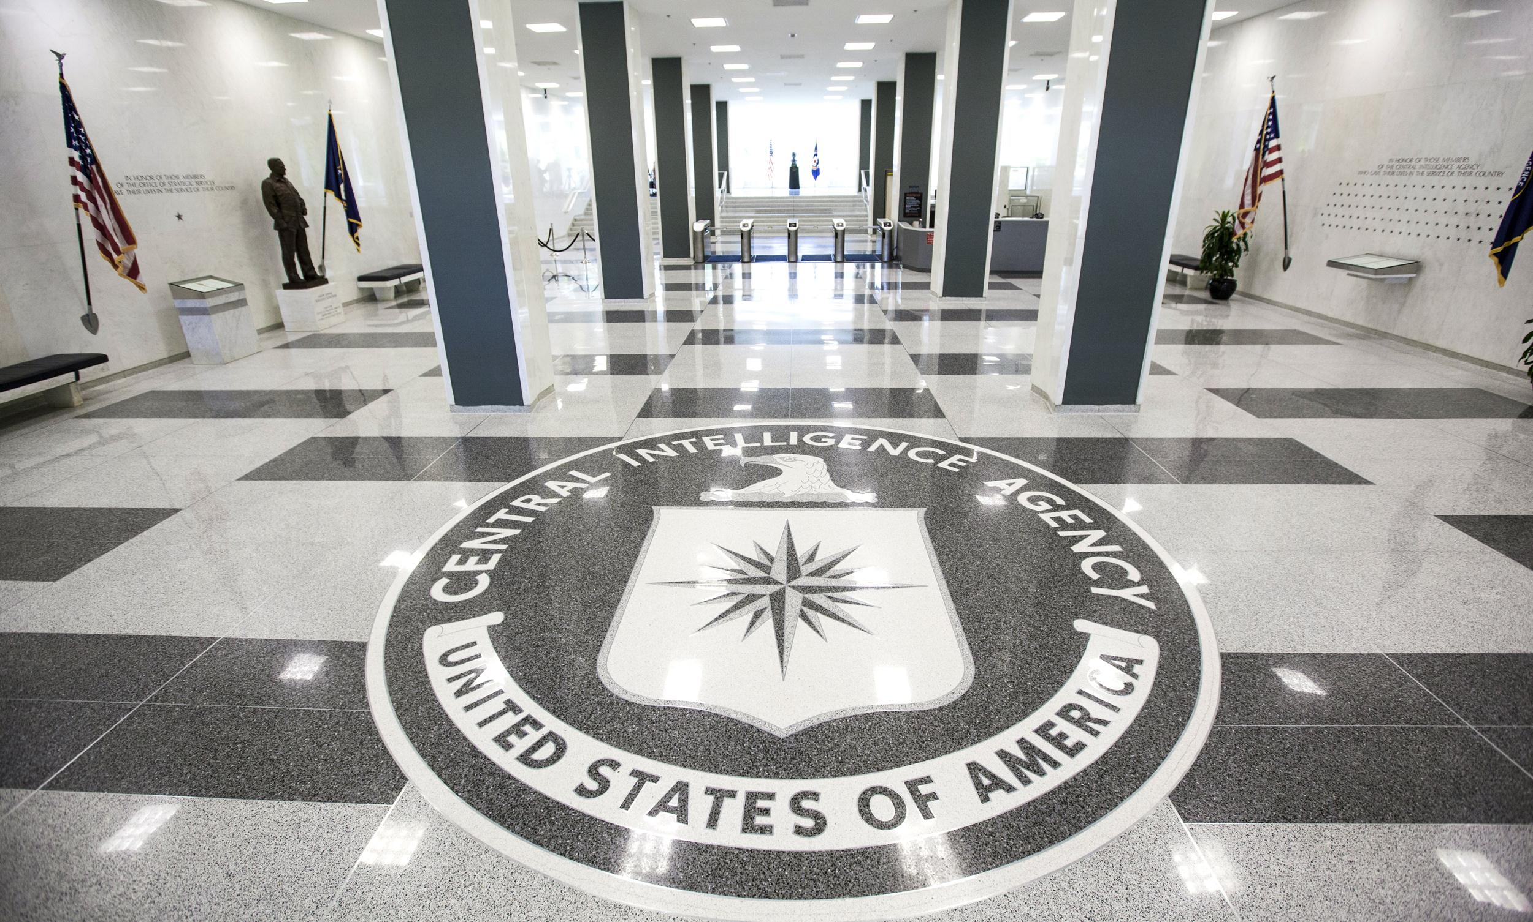
It is engraved …
John 8:32

Slide 100
It is engraved …
John 8:32

Slide 101
Questions? Comments? Concerns?

Slide 102
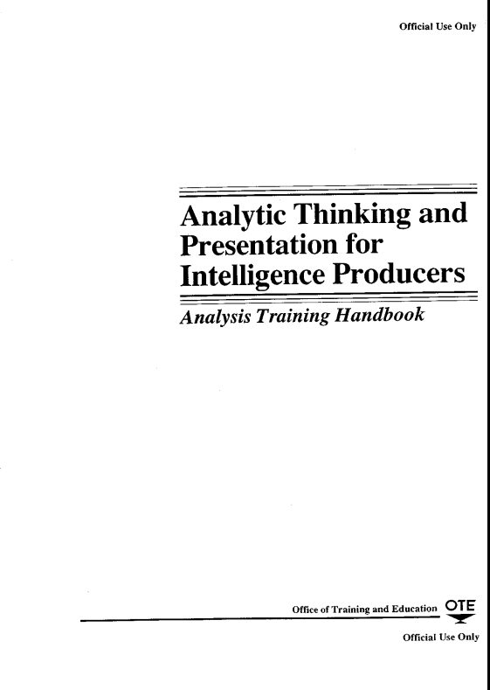
The “Other” CIA Manual
Posted in Canvas in “Analysis Guides” Module
click

Slide 103
The Intelligence Cycle

Slide 104
THE INTELLIGENCE CYCLE
Planning and Direction
Collection
Processing and Exploitation
Analysis and Production
Dissemi-nation

Slide 105
THE INTELLIGENCE CYCLE
Planning and Direction
Obtención
Procesa-miento
Análisis
Difusión
What information do our readers / consumers need? How do we pursue it?

Slide 106
THE INTELLIGENCE CYCLE
Planning and Direction
Collection
Procesa-miento
Análisis
Difusión
Where do you find the information? How do we determine its reliability?

Slide 107
THE INTELLIGENCE CYCLE
Planning and Direction
Collection
Processing and Exploitation
Análisis
Difusión
How do we prepare the data for analysis? What technology or software can help us?

Slide 108
THE INTELLIGENCE CYCLE
Planning and Direction
Collection
Processing and Exploitation
Analysis and Production
Difusión
What does the information mean? In what context is the issue evolving?

Slide 109
THE INTELLIGENCE CYCLE
Planning and Direction
Collection
Processing and Exploitation
Analysis and Production
Dissemi-nation
How do we get our analysis to our readers / consumers?

Slide 110
THE INTELLIGENCE CYCLE
Planning and Direction
Collection
Processing and Exploitation
Analysis and Production
Dissemi-nation
Feedback

Slide 111
THE INTELLIGENCE CYCLE
Planning and Direction
Collection
Processing and Exploitation
Analysis and Production
Dissemi-nation
This process makes us …
Keep ourselves and consumers up to date on issue
Revise and update our results and be self-critical
Invest resources (collection, analytical, etc.) with greater efficiency
To achieve greater success in providing ACTIONABLE ANALYSIS that enables better policies, operations, law enforcement, etc.

Slide 112
¿OK?

Slide 113
Finishing up

Slide 114
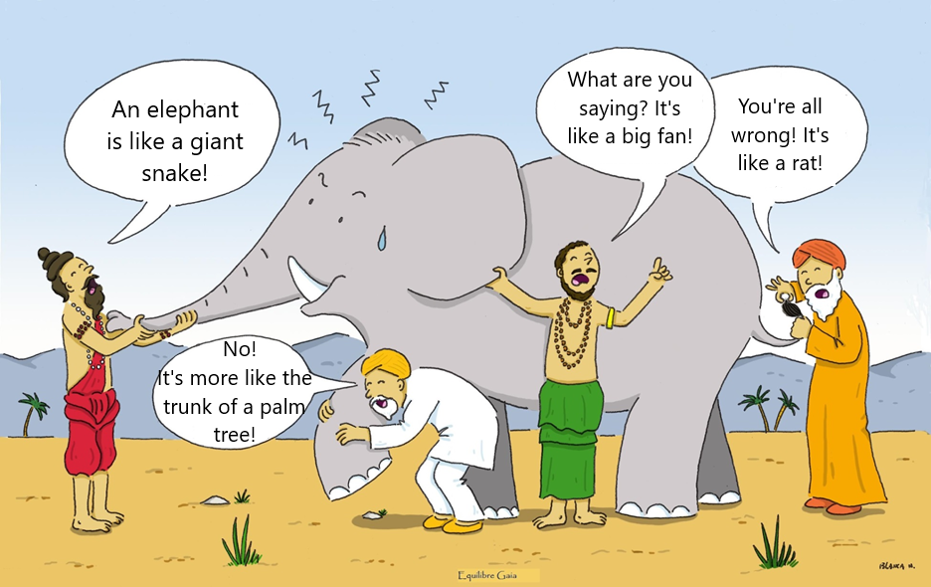
Indian Story: What is Good Analysis?
It’s trans-
parent and logical
It is ACTION-ABLE
It’s assessing data and information
It identifies DRIVERS
Notes:
Somos como en la historia india … los ciegos que quieren entender qué es un elefante. Cada uno lo toca, pero nadie entiende qué es hasta que se unan sus observaciones.
Un analista de una agencia de inteligencia … o un académico … o un periodista … o un representante de un negocio … quizás tenga información interesante, pero no es inteligencia hasta que, como sociedad, se una lo que saben y opinan del fenómeno que están observando.

Slide 115
Indian Story: What is Good Analysis?
Snowflakes
It has a BLUF!
Scenarios!
Wild Cards
Analytic Worksheets
Drivers & Trends!
Written and Oral Briefings
Notes:
Somos como en la historia india … los ciegos que quieren entender qué es un elefante. Cada uno lo toca, pero nadie entiende qué es hasta que se unan sus observaciones.
Un analista de una agencia de inteligencia … o un académico … o un periodista … o un representante de un negocio … quizás tenga información interesante, pero no es inteligencia hasta que, como sociedad, se una lo que saben y opinan del fenómeno que están observando.

Slide 116
SKILLS INSTITUTE OBJECTIVES:
Build analytic skills, with models, exercises, and tools for strengthening critical thinking on any issue, to a higher level for successful work in intelligence, policy, and nonprofit work
Increase ability to discern decisionmakers' needs, identify key drivers of events, develop future scenarios, deal with variables, and produce actionable analysis that enables clients to make sound decisions.

Slide 117
SKILLS INSTITUTE OBJECTIVES:
Build analytic skills, with models, exercises, and tools for strengthening critical thinking on any issue, to a higher level for successful work in intelligence, policy, and nonprofit work
Increase ability to discern decisionmakers' needs, identify key drivers of events, develop future scenarios, deal with variables, and produce actionable analysis that enables clients to make sound decisions.

Slide 118
SKILLS INSTITUTE OBJECTIVES:
Build analytic skills, with models, exercises, and tools for strengthening critical thinking on any issue, to a higher level for successful work in intelligence, policy, and nonprofit work
Increase ability to discern decisionmakers' needs, identify key drivers of events, develop future scenarios, deal with variables, and produce actionable analysis that enables clients to make sound decisions.

Slide 119
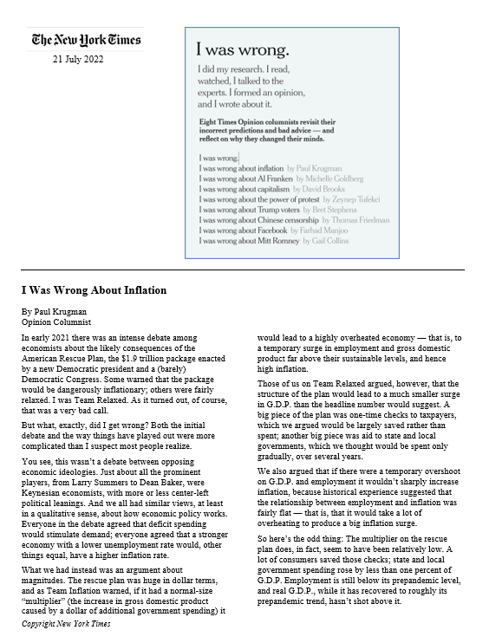
Analysis is challenging but …
satisfying,
important,
and within our reach.
Consult and, where feasible, use the handouts on future projects, and let me know how they go.
Questions or Comments?

Slide 121
 |  |  |  |  | 27 | 28
29
AGENDA
THE DECISIONMAKER AND “ACTIONABLE” ANALYSIS
✓
✓
The decisionmaker’s needs
Developing the right question
Tradecraft and its importance in critical thinking
Models, techniques, tricks
Drivers, scenarios, alternatives, wildcards, implications
Guaranteeing quality, integrity

Slide 122
 |  |  |  |  | 4 | 5
6
AGENDA
Implementing the full model
Providing comments
Reinforcing skills
Avoiding pitfalls, pressures
How others train analysts
Preparing for production
✓
PRACTICING AND PREPARING “ACTIONABLE” ANALYSIS

Slide 123
Thank you.
EVALUATION, please
(It’s important. I am giving you class time to do it.)
fultona@american.edu

Slide 124
Sharpening Analytic Skills
Fulton T. Armstrong
Course # SIS-730-010
Friday 10/27 | Saturday 10/28 | Sunday 10/29
5:30pm - 8pm | 9am - 5pm | 9am - 5pm
SIS-333 | SIS-355 | SIS-355

